Slide 1
Power Pipelines and Enhanced ALM
WORDS

Slide 2
WHO IS ANDWORX
Andworx
Who is Ed

Slide 3

Power Pipelines
Power Pipelines is the built in tool to push solutions between environments
Because it is all apart of Dataverse and the Power Platform it can be extended using other Power Platform and O365 tools
A natural extension is the ability to place governance on solutions being developed
Power Pipelines Documentation

Slide 4
Extending Pipelines
Governance
Governance is the holy grail for Power Platform Administrators
Instead of relying on CoE to tell us AFTER something has happened, we can control what it is to be added and by whom
Approvals
Approvals are a simple feature of pipelines but can be extended greatly

Slide 5
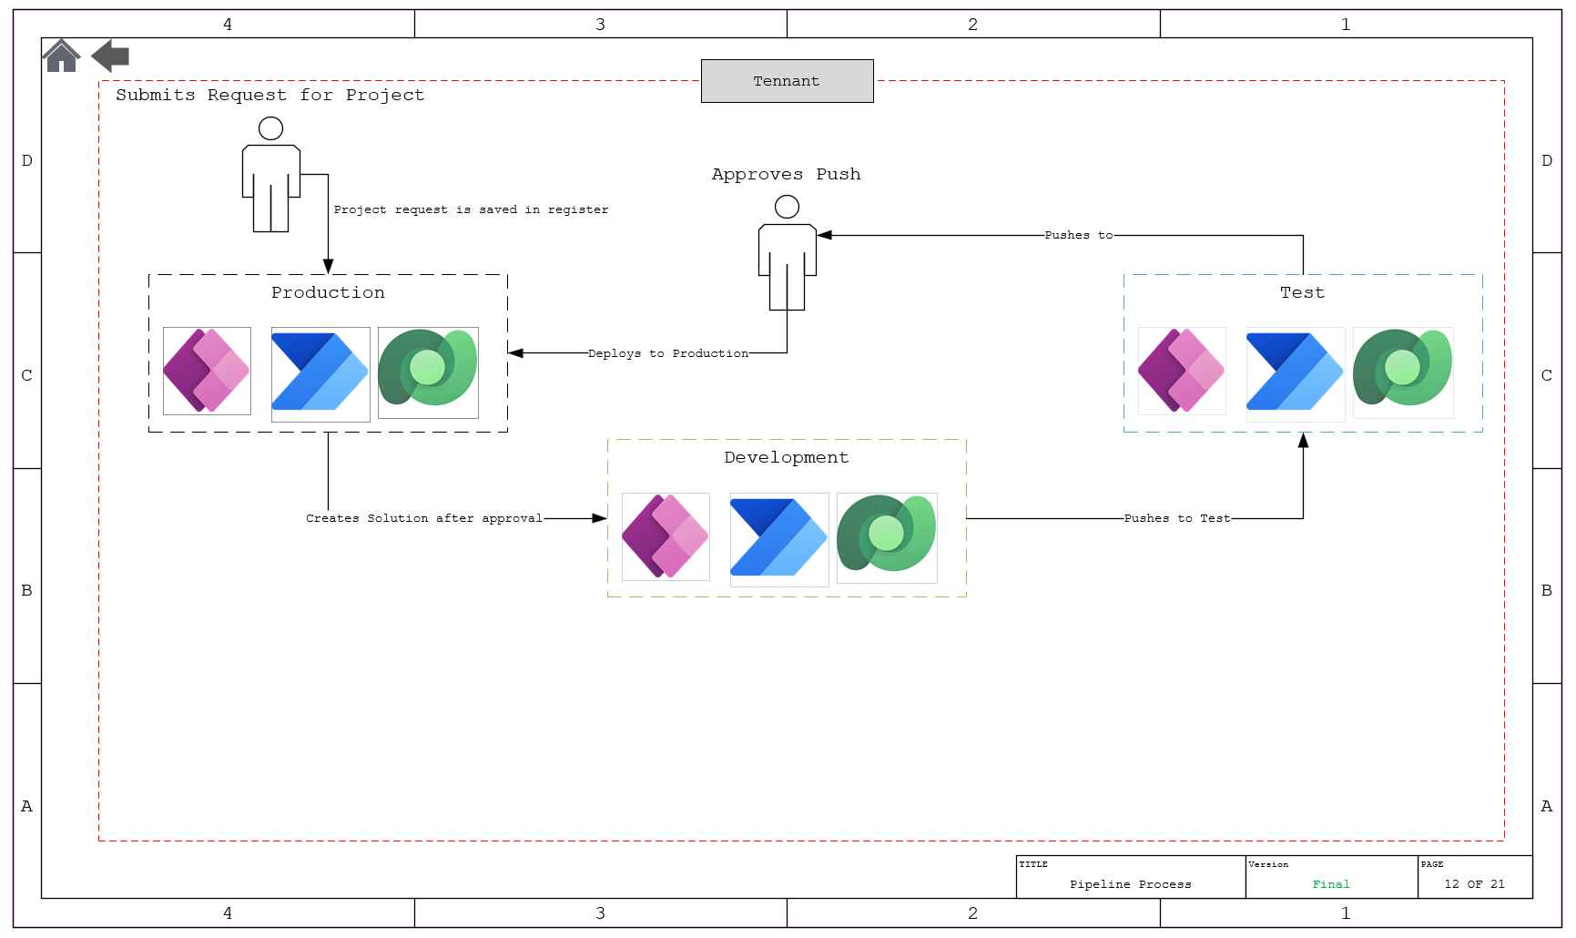
Whats happening

Slide 6

Solution Register
Collecting information about the solution
Who is the Customer
Who is the Project Lead
Can be expanded to whatever categories we you want

Slide 8
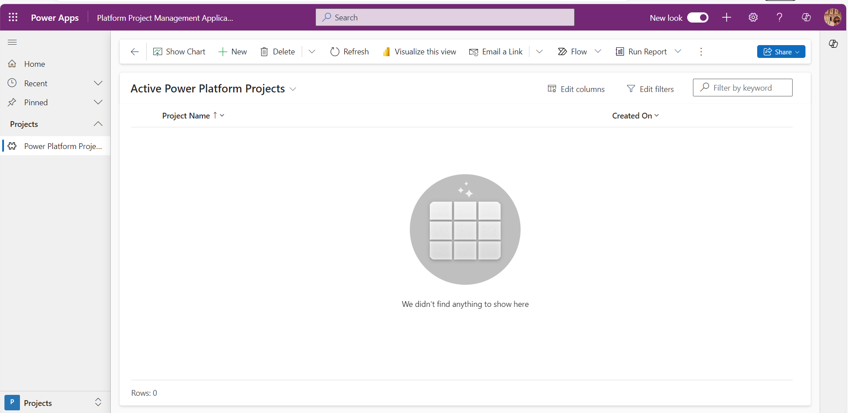
Projects

Slide 9
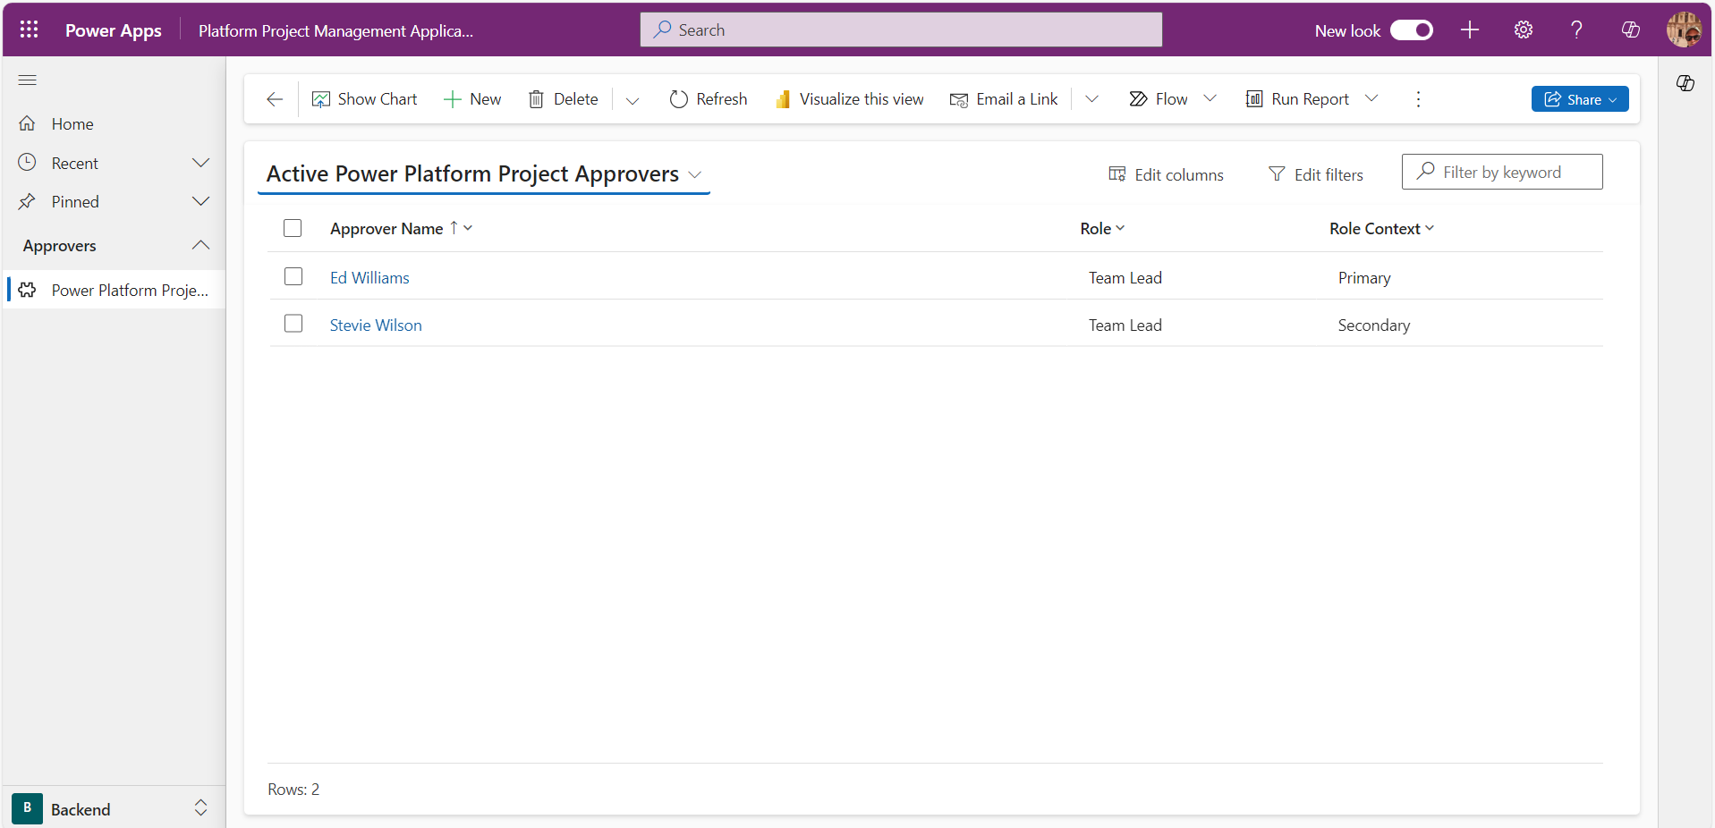
Approvers

Slide 10
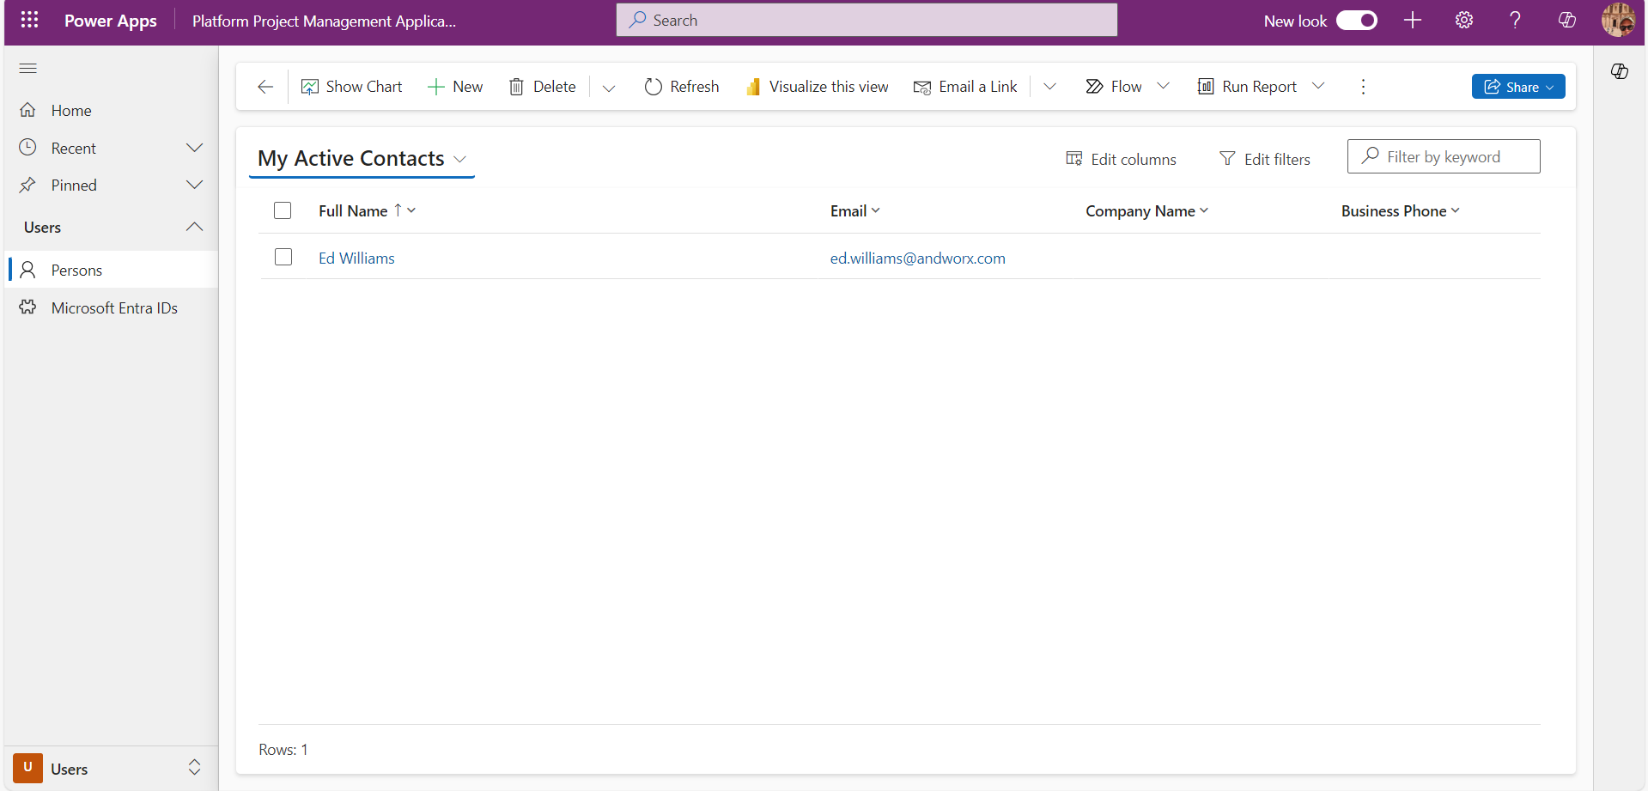
Customers

Slide 11
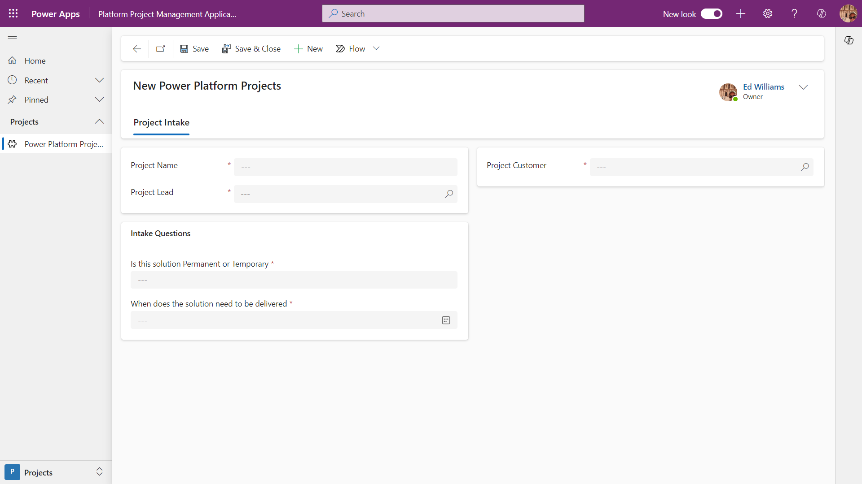
Collecting Solution Information

Slide 12
Approving Project
A project request is sent to the first line approver defined in the approvers table

Slide 13
Pushing to Production

Slide 14
What happens when you don’t register

Slide 15

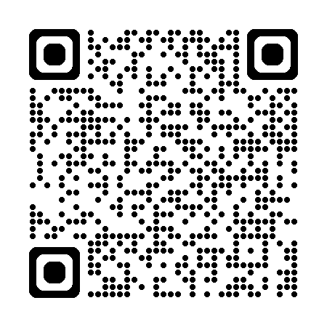
Resources
GitHub
LinkedIn

